Slide 1
MULTILINGUAL CAREER GUIDANCE PLATFORM FOR RURAL, TRIBAL & SEMI URBAN STUDENTS
Low-Fi Prototype
Team 1
CS435: Human Computer Interaction
Ashmit Chhoker
Dewansh Singh Chandel
Neerja Kasture
Tapananshu Gandhi

Slide 2
CONTENTS
01. User requirements & Data gathering methods
02. Personas & Scenarios
03. Wireframe & Screenflow Navigation
04. Sitemap/Flow Diagram
05. Annotations & Clickable regions
06. Storyboard
07. Error messages & System Feedback
08. Task instructions for usability testing

Slide 3
User Requirements
Inclusive and Trust-Building Design
Only 38% of the households are digitally literate in India. Thus, the system must be easy to use for students with limited digital literacy, use visual or voice support where possible, and present information in a way that builds confidence and trust rather than confusion.
Multilingual interaction
The system must allow students to interact in their native or regional language, with culturally sensitive phrasing and examples that reflect their local context and educational environment.
Holistic and Context-Aware Career Assessment
Conversational and Personalized Guidance
The platform should assess aptitude, interests and values, while accounting for financial or practical limitations.
Students should receive instant, understandable, and empathetic feedback through a chatbot or interactive interface that explains results, career options, and next steps in plain language.

Slide 4
DATA GATHERING METHODS
1.
SYSTEMATIC LITERATURE REVIEW
2.
REVIEW OF EXISTING CAREER ASSESSMENTS
3.
USER INTERACTION & INTERVIEW
We conducted a systematic literature of which we shortlisted 17 papers that explored works exploring this problem statement. Through the extensive review we were able to explore the problem space, user needs and gaps in the existing solutions for them.
Reviewed various assessments such as RIASEC test, NCERT’s career guidance test, UK national career service test and more.
Met kids studying in Nyasa at IIT Gandhinagar to understand their needs

Slide 5

Scenario 1
Priya, a 15-year-old 10th-grade student from a small town in India. She is bright but anxious about choosing a career. Her parents, though well-meaning, keep encouraging her to choose a “safe” path like engineering or medicine options that don’t really excite her. Still, she’s unsure what else is out there or how to even start exploring. That uncertainty is what truly drives her right now.
Persona 1 - Priya
*AI generated image, only representative

Slide 6

Scenario 2
A young tribal girl from the forest area of Gujarat with no smartphone or internet access, all she has is a basic mobile phone. Since Kaya only has a basic mobile phone with no internet access, she needs a solution that would work through simple voice calls or SMS in her local language.
Persona 2 - Kaya
*AI generated image, only representative

Slide 7
PROTOTYPES
A multilingual, AI-driven career guidance platform that helps students discover their strengths through carefully curated aptitude, values, and personality assessments. It offers instant, personalized insights through an interactive chatbot and a seamless, low-setup interface.
01.
Prototype 1 - Webapp
A multilingual, call-based career guidance system designed for accessibility even without internet or smartphone access. The user simply calls a toll-free number, takes the test with our career assessment bot, and gets a full career guidance report via SMS
02.
Prototype 2 - Phone Based

Slide 8
Low-Fi Prototype 1
Content:
Likert scale based Assessment for aptitude & interests, values & motivation and personal information
Based on RIASEC (Holland Code) framework and NCERT Questionnaire
Chatbot provides information related to career path, requirement, salary etc.
Features:
Chatbot for Instant Guidance
New chat opened for every assessment, all past chats accessible in past assessments page
Offers real-time answers to questions about career options, courses, and subjects
Available in multiple languages for accessibility
Multilingual Support
Text and UI available in regional languages for inclusivity.
Switchable at any time for easy navigation
Usability
All labels and buttons are intuitive for usage
Usage instructions given before attempting each section in assessment
Link

Slide 9
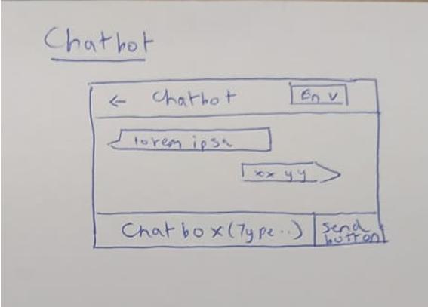
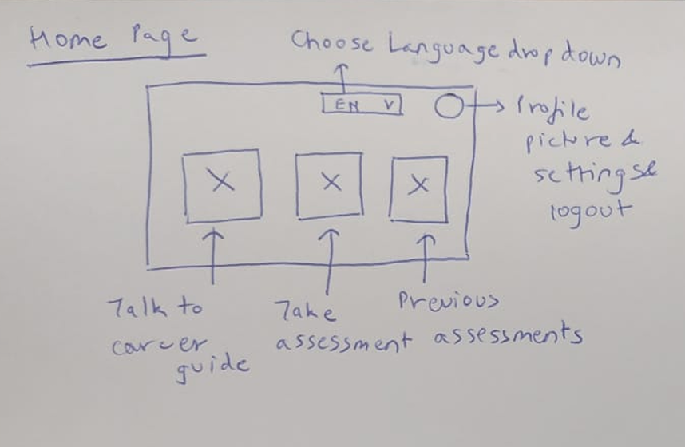
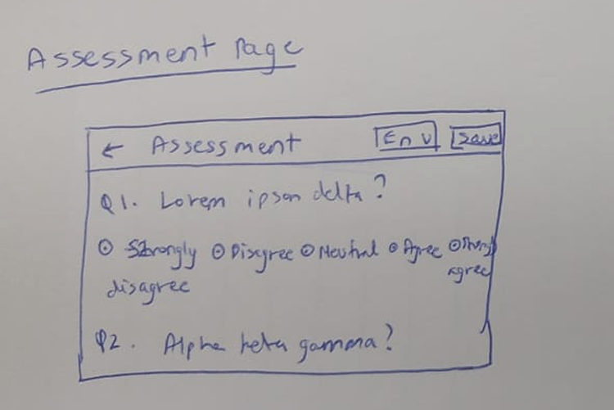
Chatbot page
Main Page
Assessment Page

Slide 10
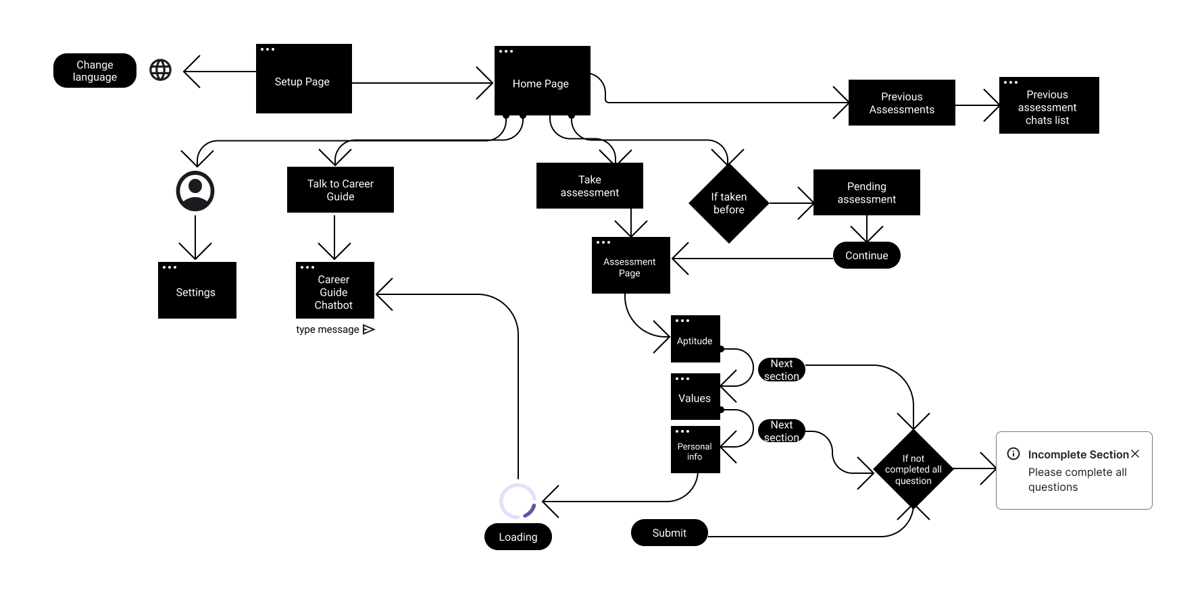
SITEMAP

Slide 11
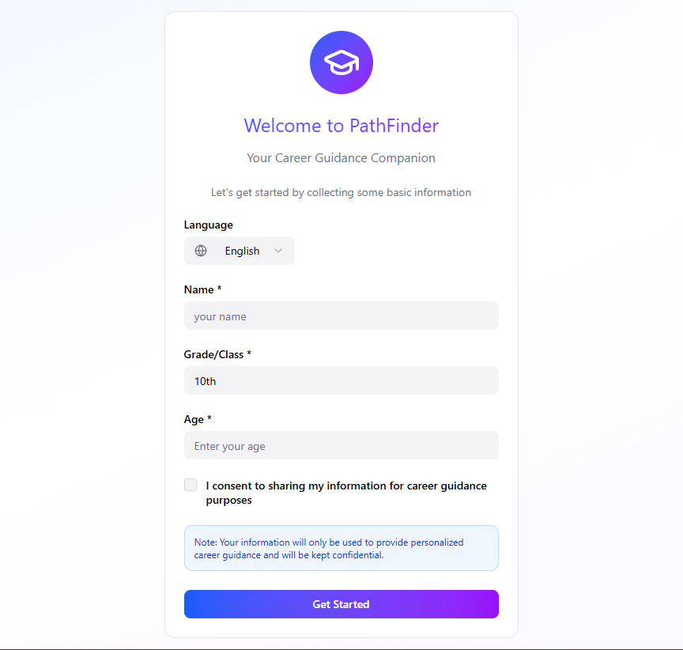
Setup Page
Page Elements
Input fields - Name, Grade/Class , Age
Consent checkbox
Language Dropdown
Login Button ( Linking to Home Page)

Slide 12
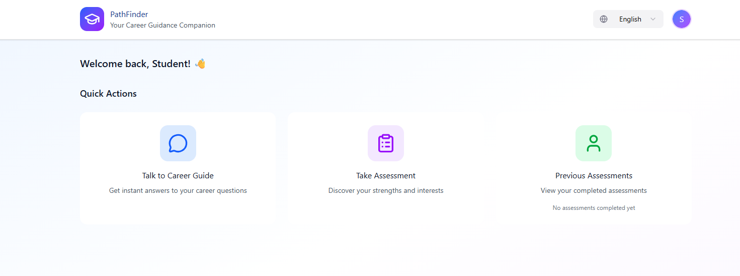
Home Page
Page Elements
Language drop down
Buttons- Career guide chatbot, New Assessment, Previous Assessments
Profile logo ( top right) - link to profile settings page

Slide 13
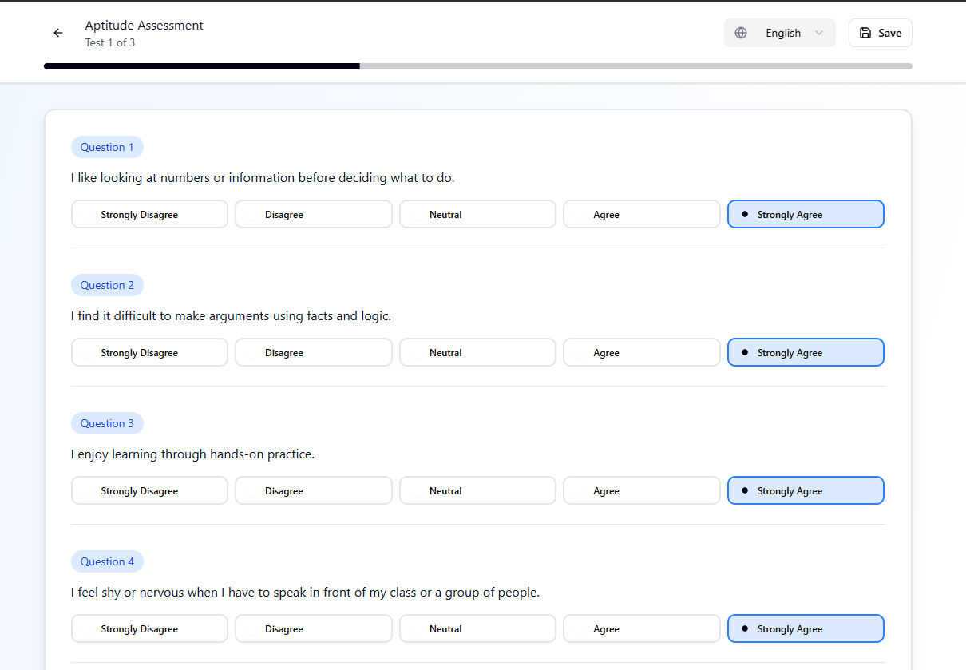
New Assessment - Section 1 Aptitude
Page Elements
Language Dropdown (top right)
Previous Arrow (top left)- Linking back to home page
Buttons - Save progress (top right), Next Section (bottom right)
Questions - Total of 33 questions with 5 options -
Strongly Disagree
Disagree
Neutral
Agree
Strongly Agree

Slide 14
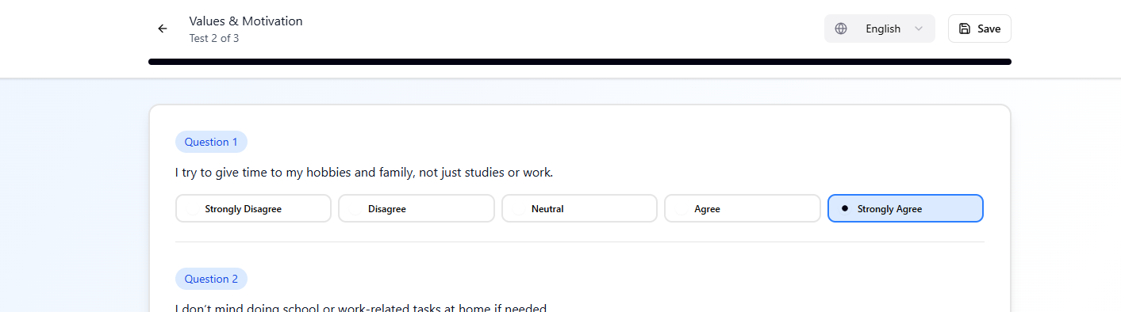
Section 2 Values & Motivation
Page Elements
Similar Page elements and user activity feedback
Section 2 - Total of 17 questions with 5 options -
Strongly Disagree
Disagree
Neutral
Agree
Strongly Agree

Slide 15
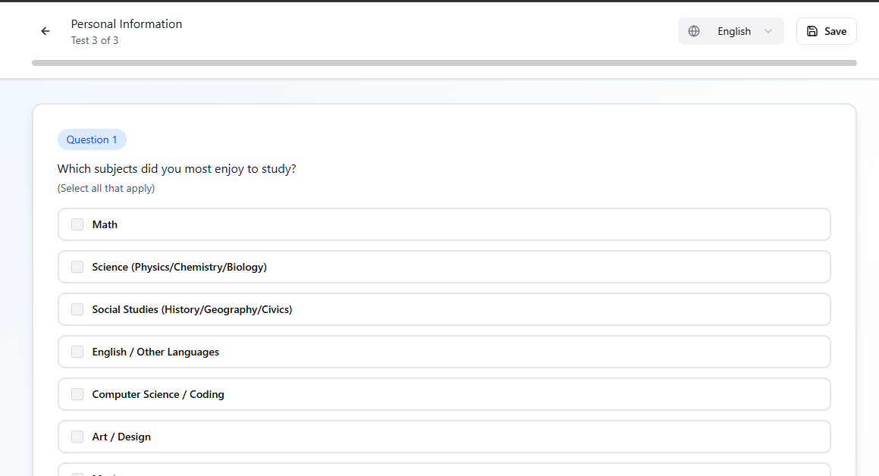
Section 3 Personal Information
Page Elements
Submit Assessment button ( bottom right)- Linking to chatbot option
Total of 3 questions
Two options based
One text input

Slide 16
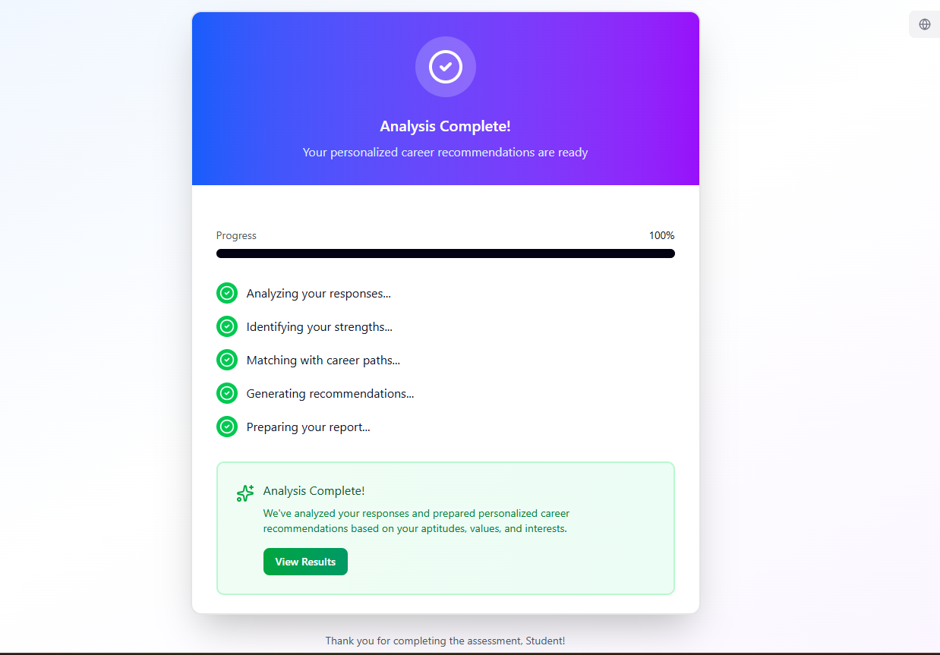
Loading window After Assessment Completion
User feedback is given using a loading screen while the backend is analyzing the report.
Page Elements
Button - View Results ( Bottom Left ) - Linking to AI chatbot for further guidance
Language Dropdown
View Results - Takes to chatbot page with a response based on the analysed assessment data

Slide 17
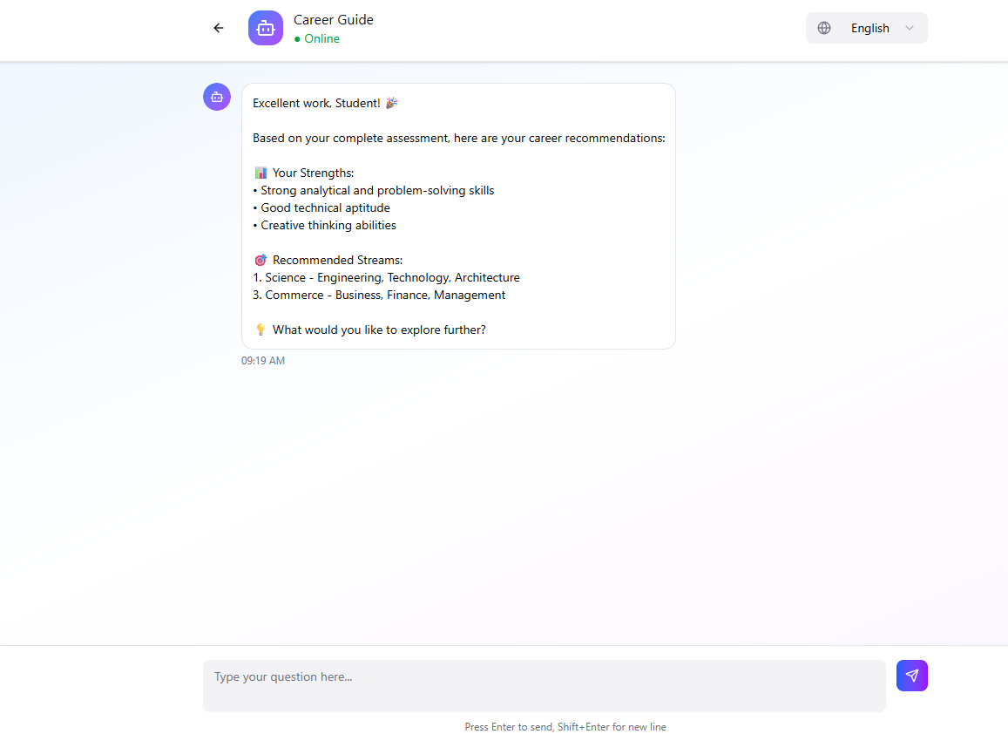
Chatbot Interface
Page Elements
Text Input field ( button ) - Input from user
Language dropdown
Chatting interface similar to current chatbox interfaces for consistency
Previous button ( top left)- User to transition back to home page where either can take a new assessment or continue the current chat.

Slide 18
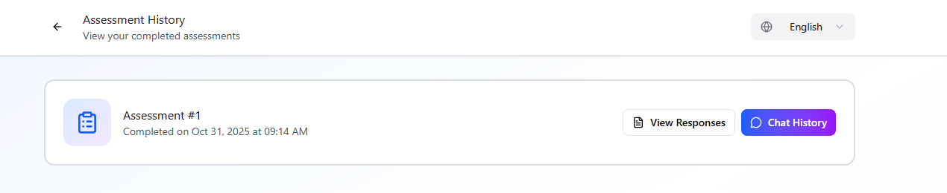
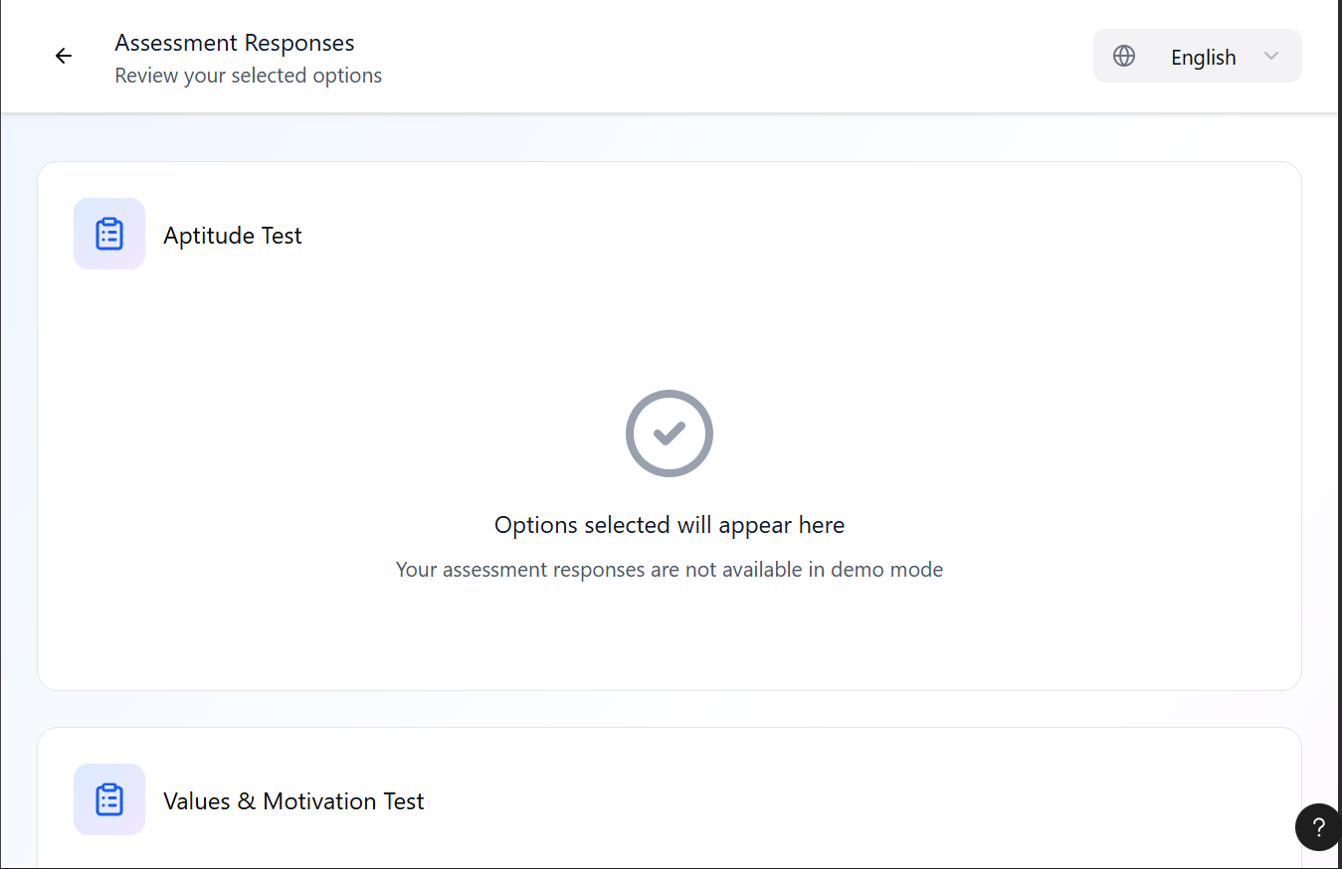
Previous Assessment
Uses can view its previous responses and chat history using the previous assessment button in the home page.
Page elements
Buttons - View assessment responses , Chat history
Previous Arrow( top left), Language Dropdown ( top right)

Slide 19
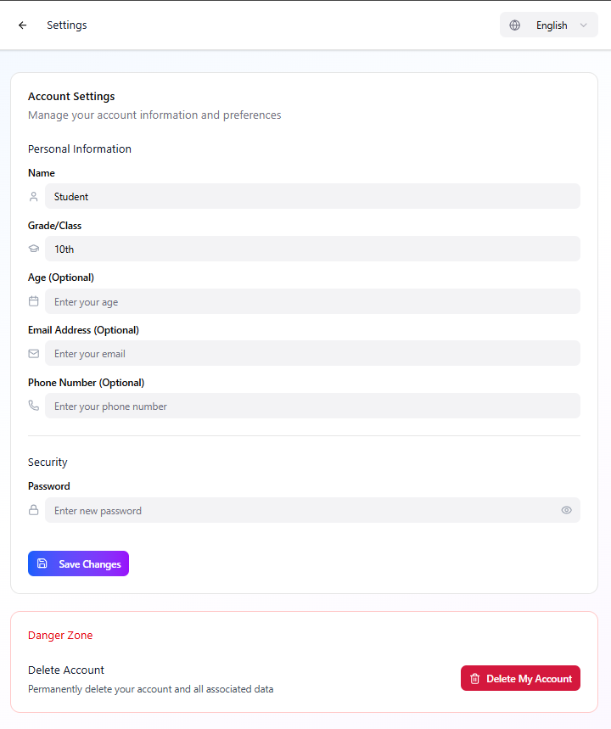
Profile Settings
Page Elements
Buttons- Delete User Account, Save changes
Input fields - Personal information, new password field
Previous Arrow( top left), Language Dropdown ( top right)

Slide 20
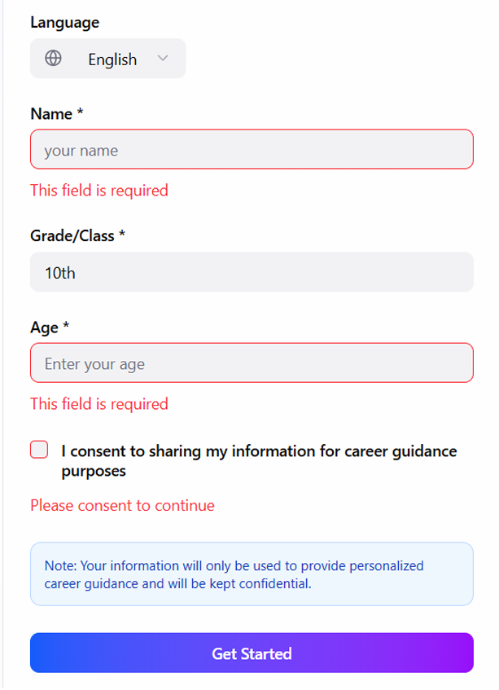
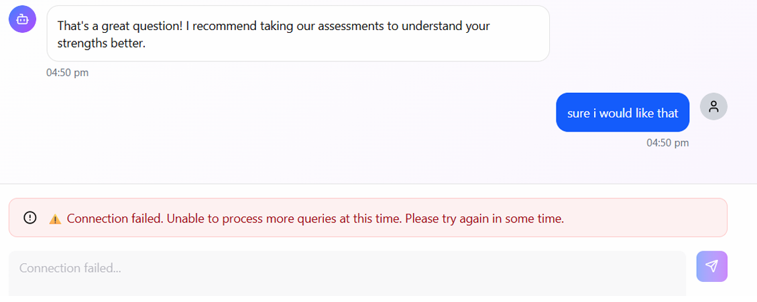
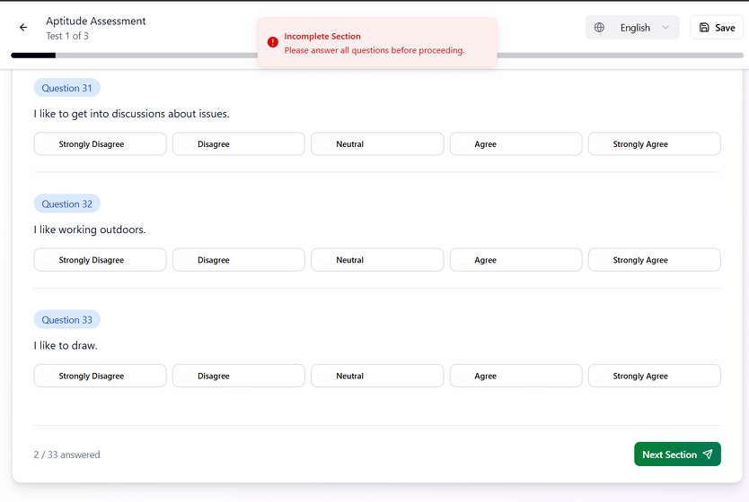
ERROR MESSAGES

Slide 21
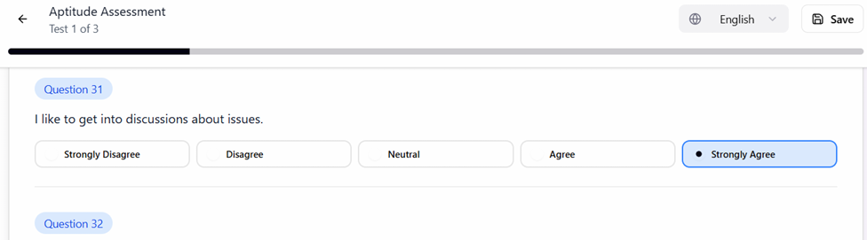
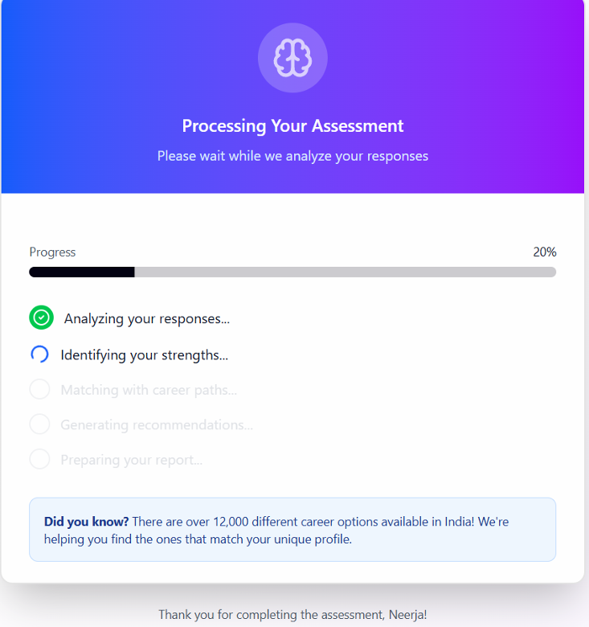
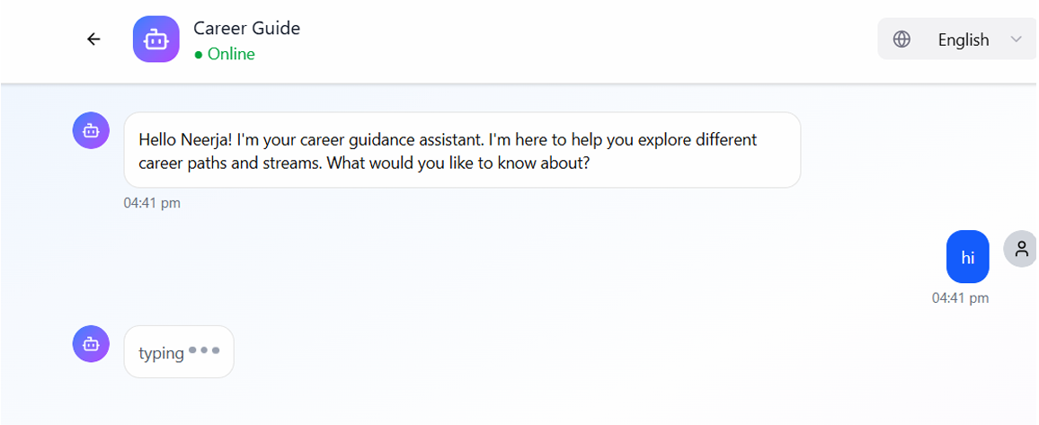
SYSTEM FEEDBACK

Slide 22
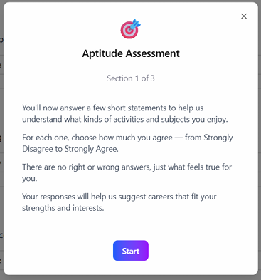
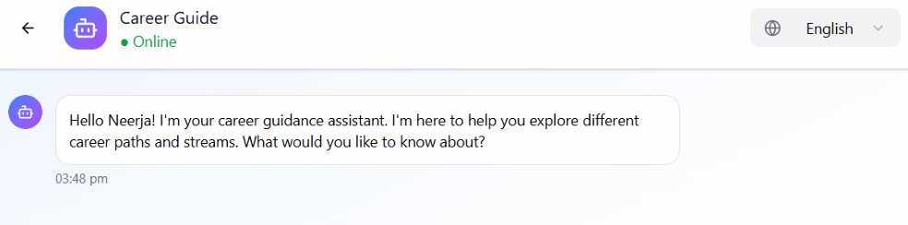
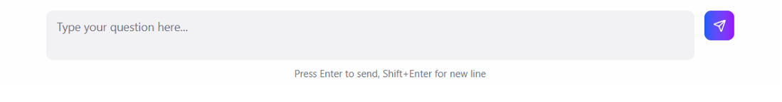
TASK INSTRUCTIONS FOR USABILITY TESTING

Slide 23
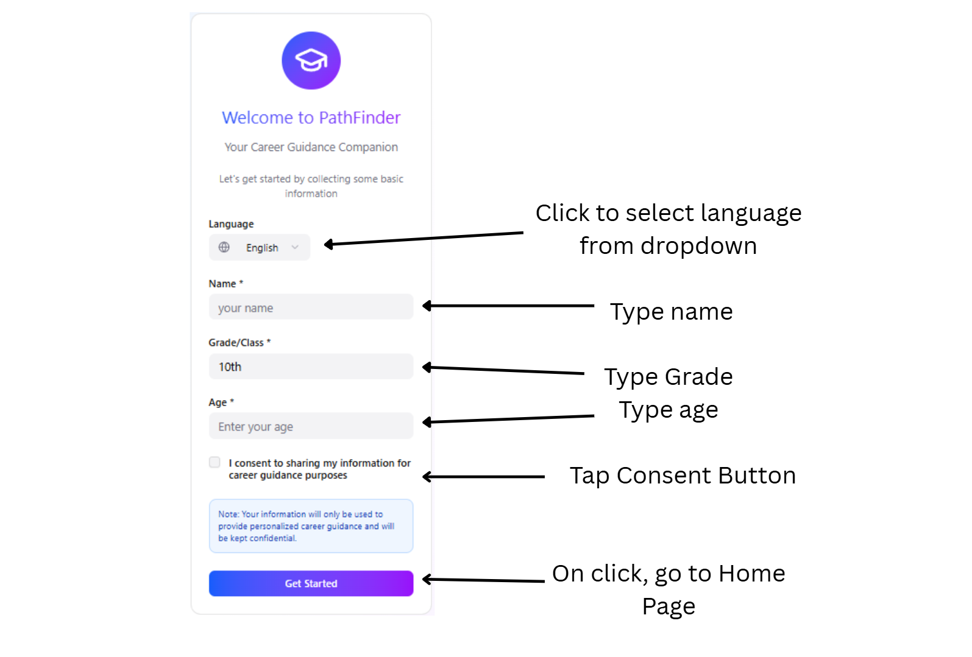
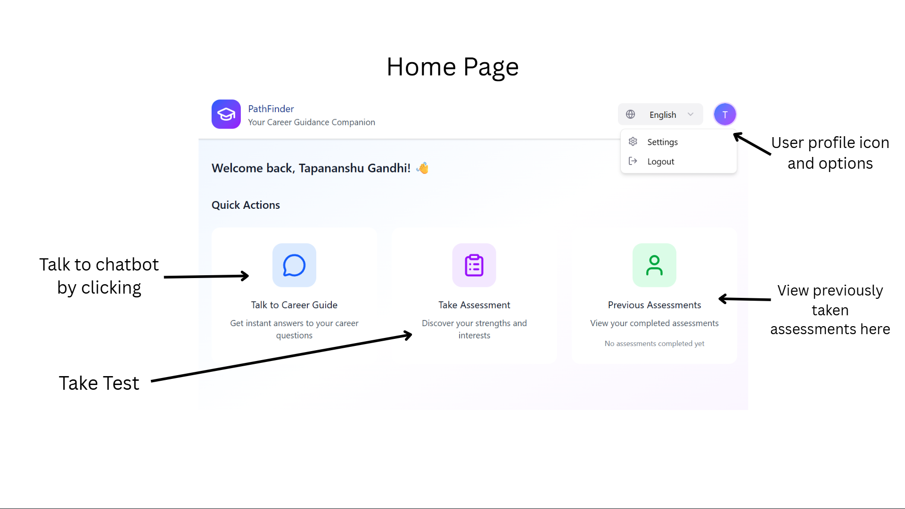
Annotated Interface

Slide 24
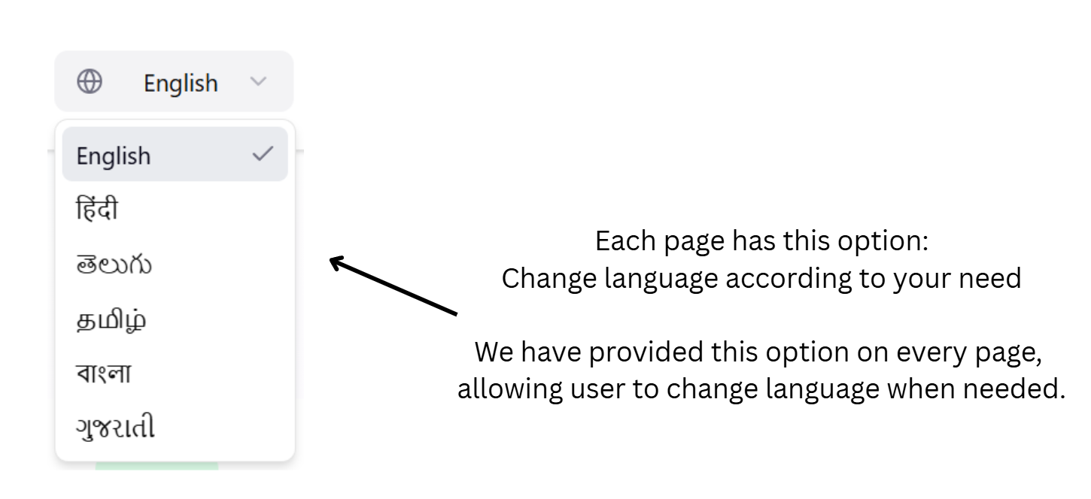
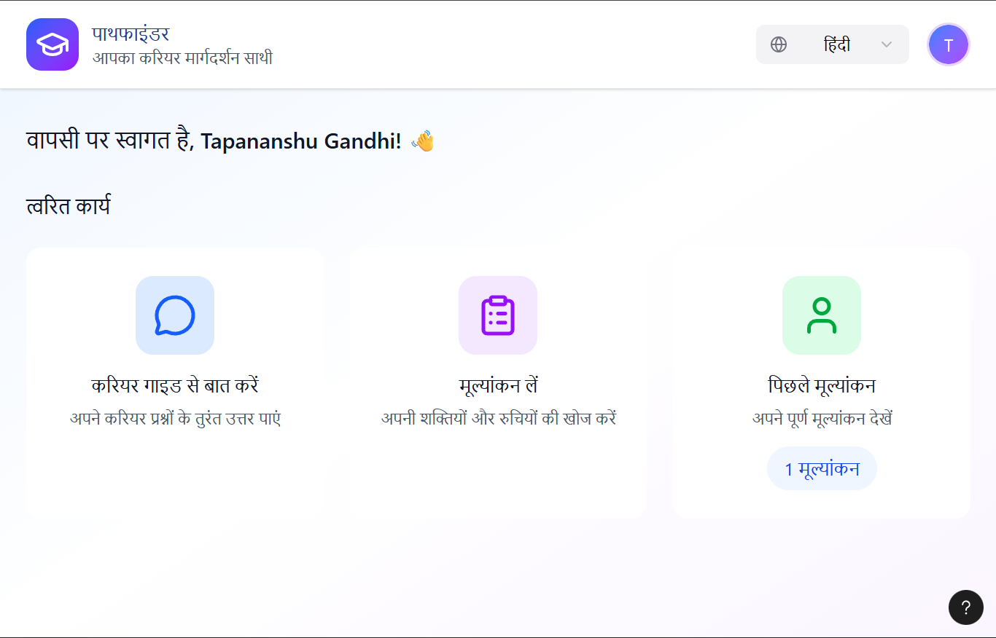

Slide 25
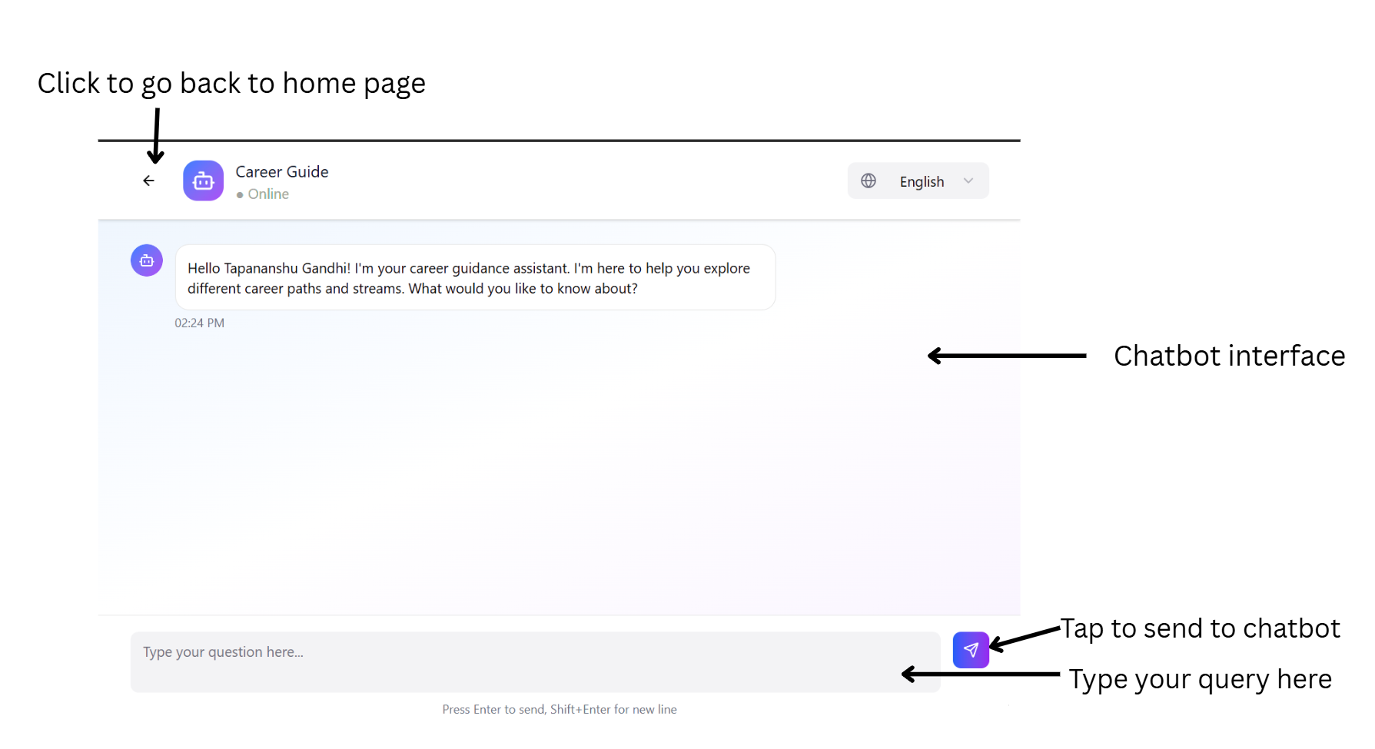

Slide 26
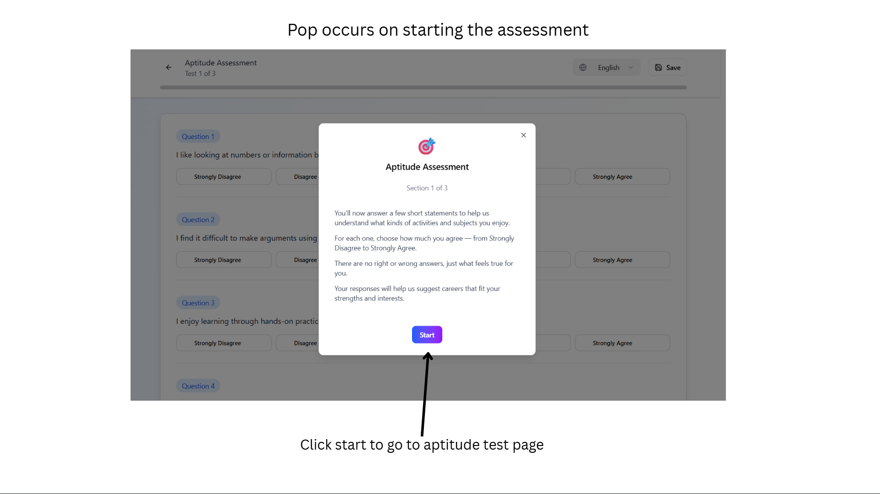

Slide 27
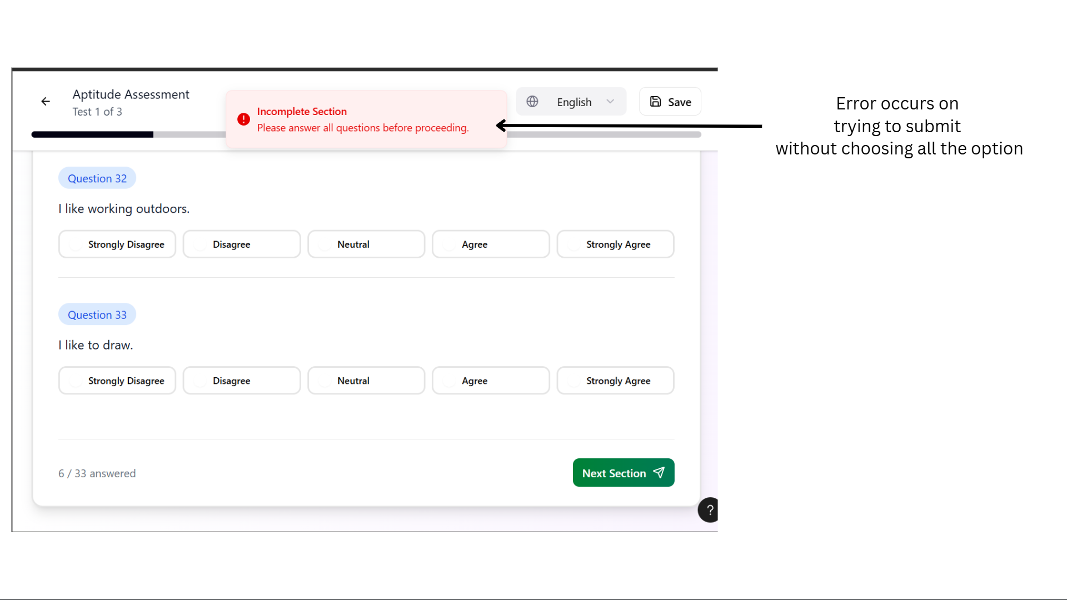

Slide 28
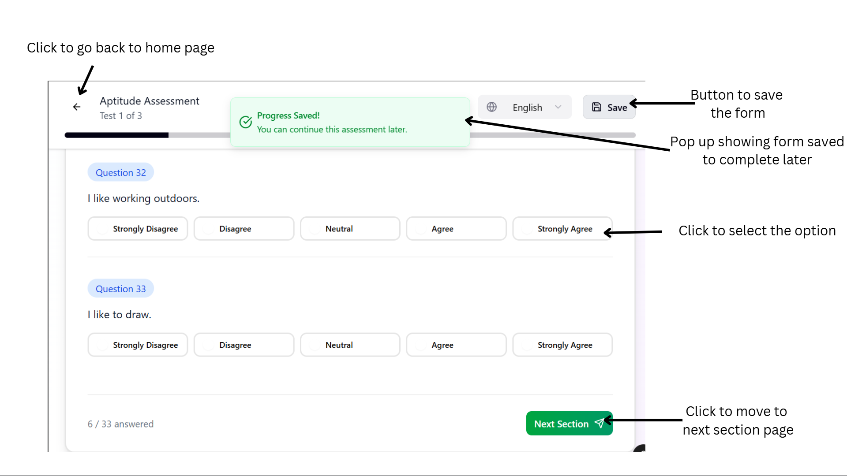
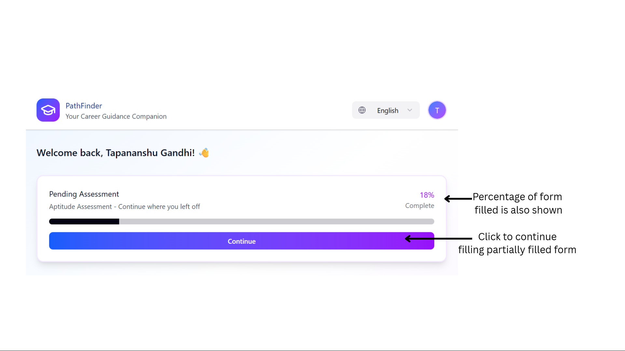

Slide 29
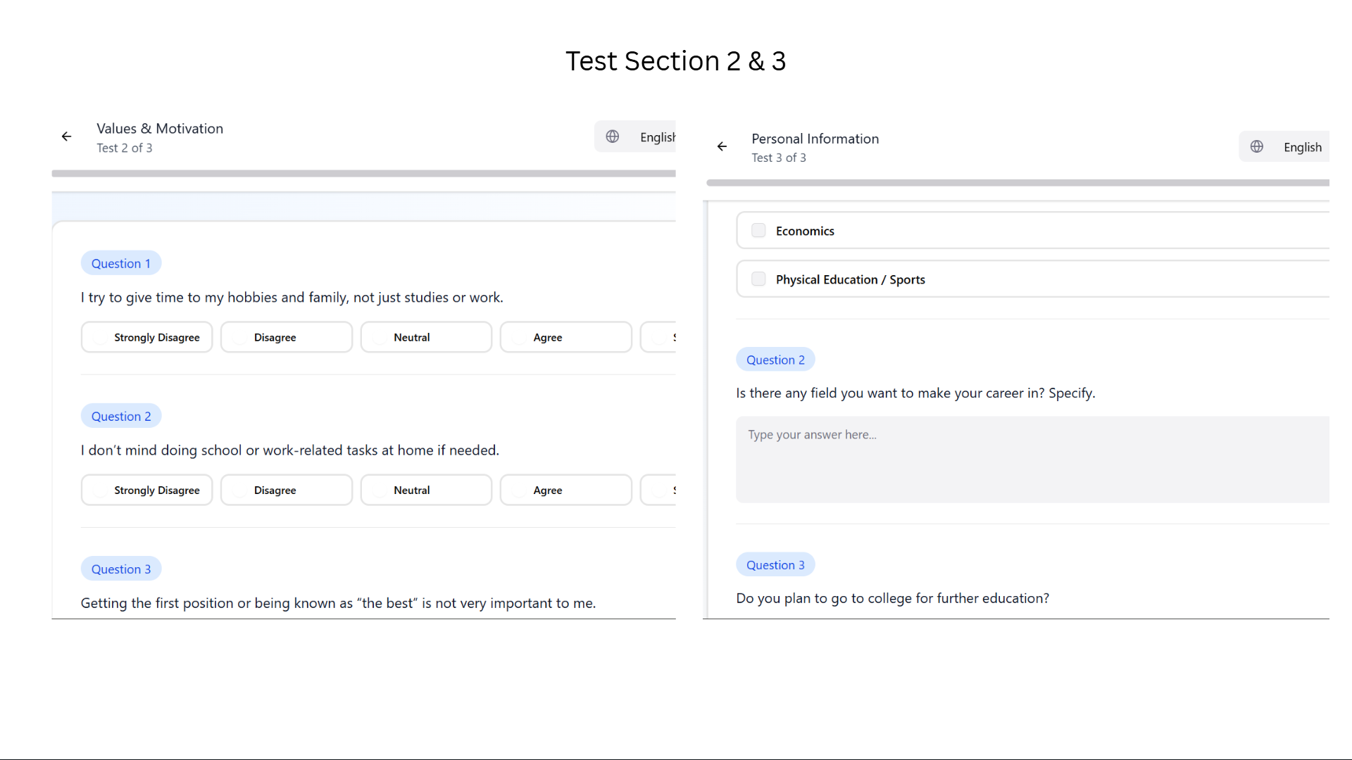

Slide 30
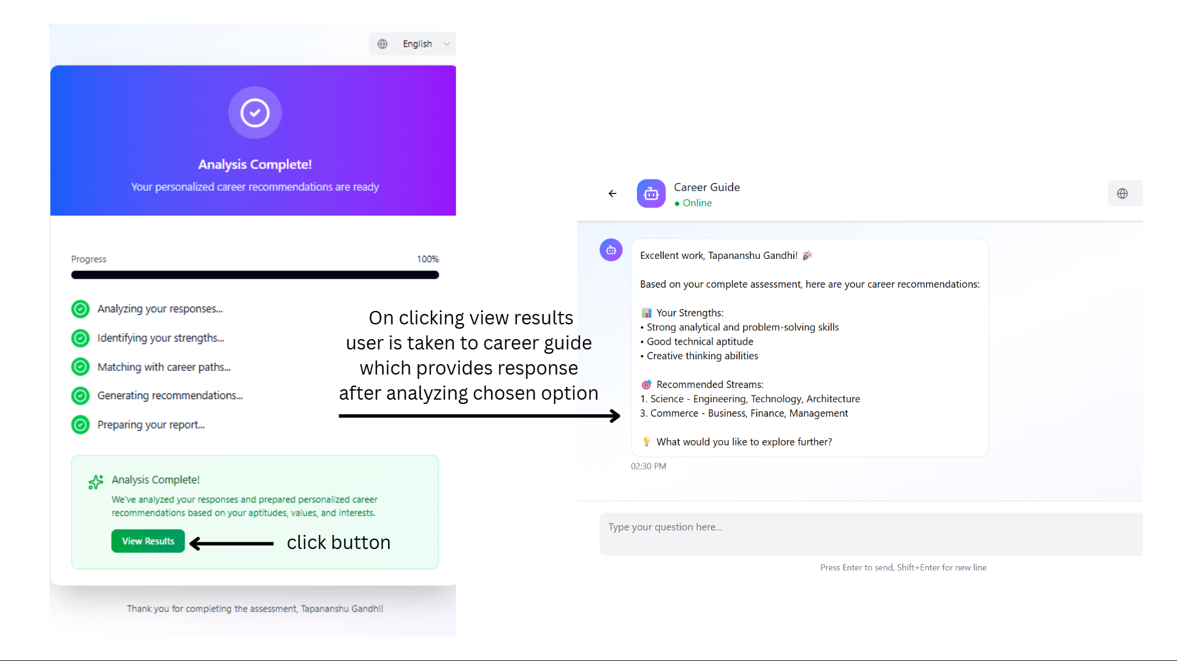

Slide 31
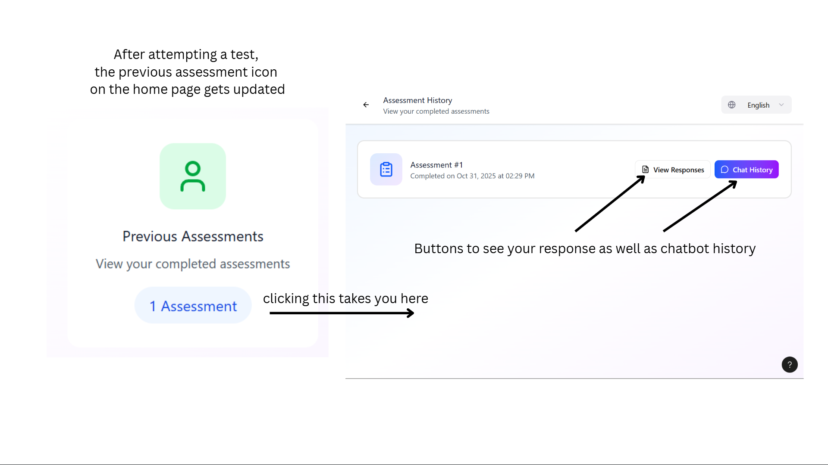

Slide 32
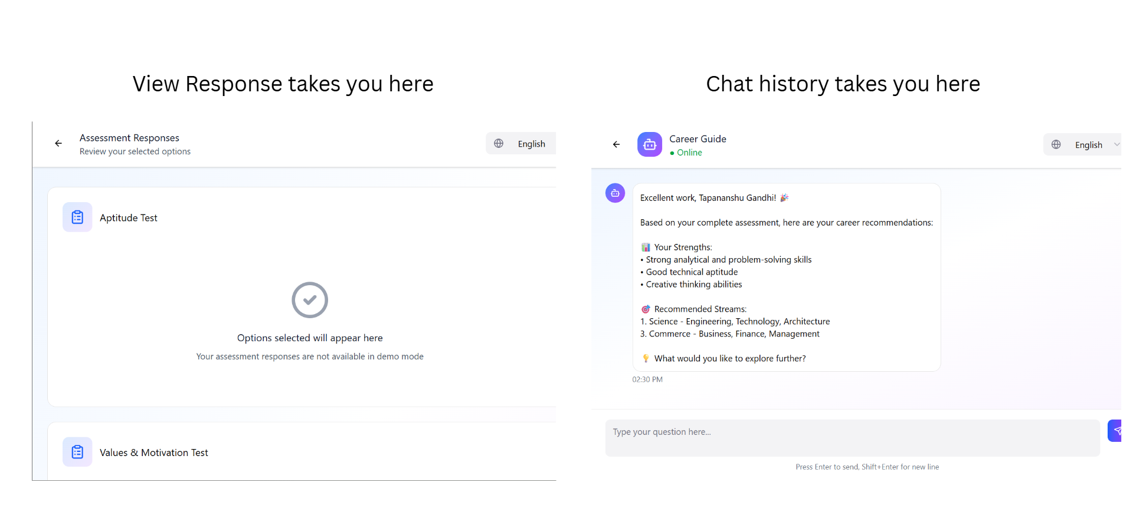

Slide 33
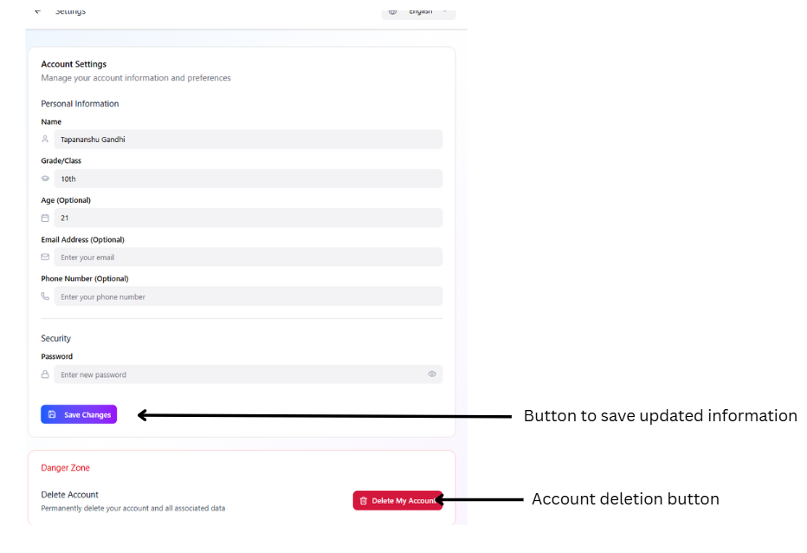

Slide 34
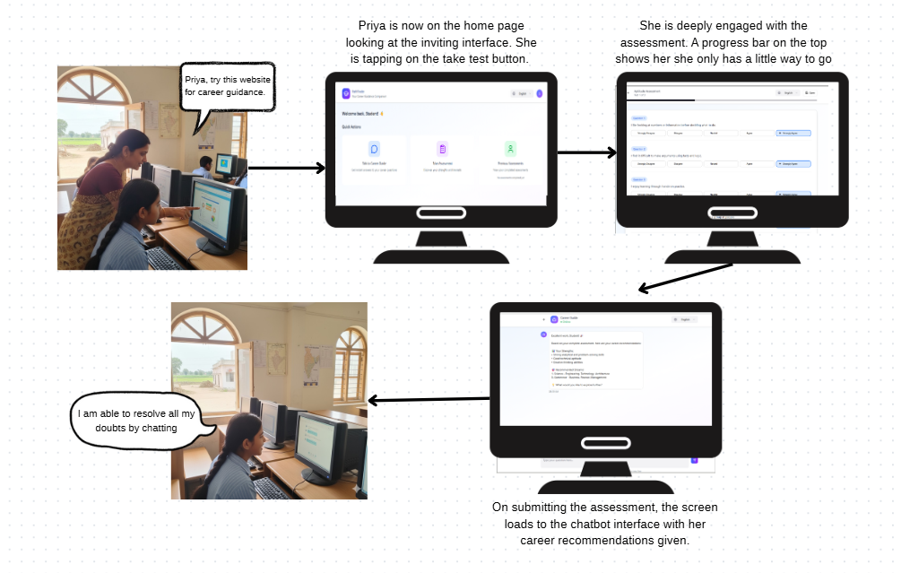
Storyboard - Prototype 1 ( Persona - Priya )

Slide 35
PROTOTYPES
A multilingual, AI-driven career guidance platform that helps students discover their strengths through carefully curated aptitude, values, and personality assessments. It offers instant, personalized insights through an interactive chatbot and a seamless, low-setup interface.
01.
Prototype 1 - Webapp
A multilingual, call-based career guidance system designed for accessibility even without internet or smartphone access. The user simply calls a toll-free number, takes the test with our career assessment bot, and gets a full career guidance report via SMS
02.
Prototype 2 - Phone Based

Slide 36
Low-Fi Prototype 2
Content:
Subjective Assessment for aptitude & interests, values & motivation and personal information
Based on RIASEC (Holland Code) framework and NCERT Questionnaire
Features:
SMS based report
A full career guidance report, including strengths, weaknesses, career recommendations and next steps sent via SMS.
Multilingual and Voice Support
Can take assessment simply by answering questions on the phone in their own native language - no dependence on smartphones or internet
Recording Link

Slide 37
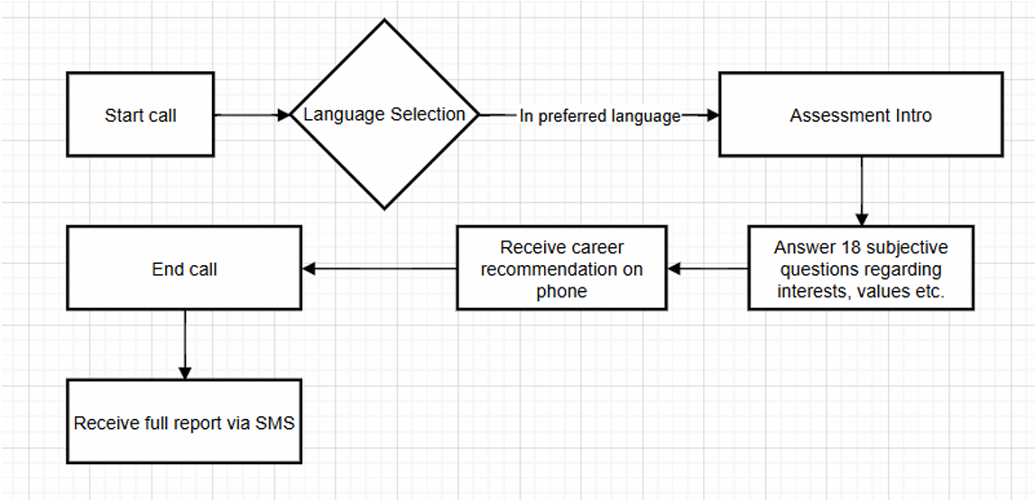
FLOW DIAGRAM

Slide 38
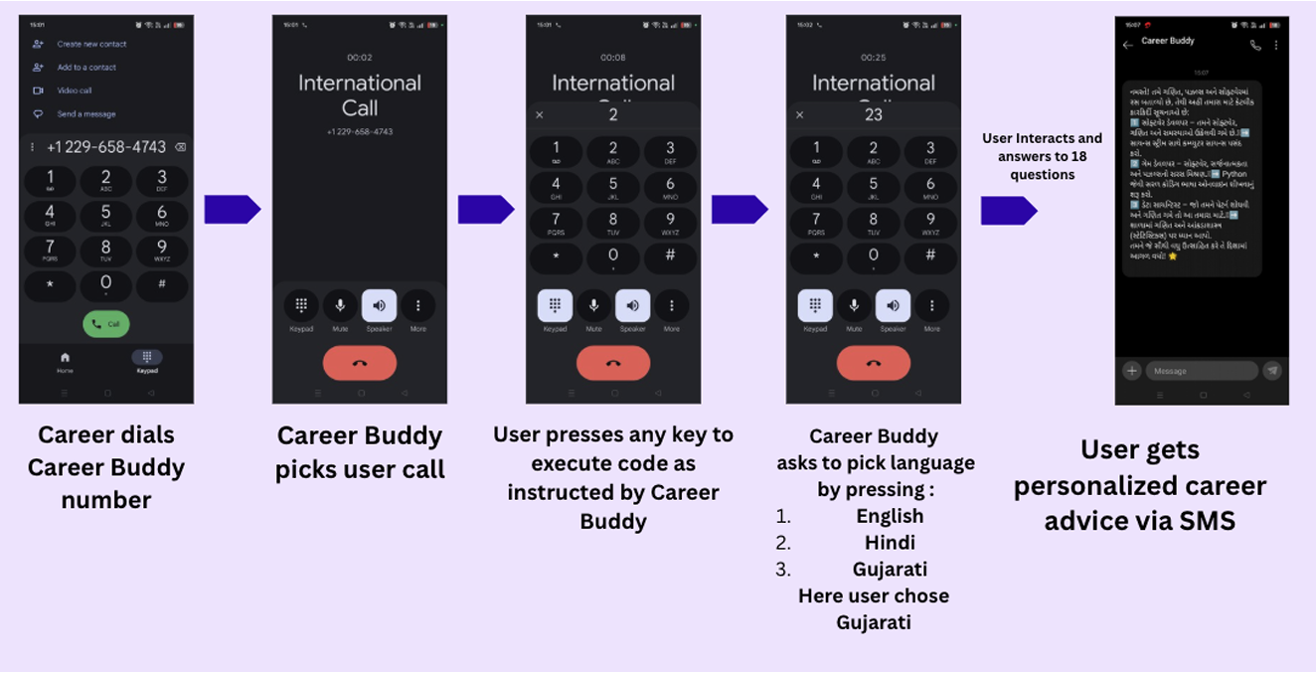
Screenflow navigation

Slide 39
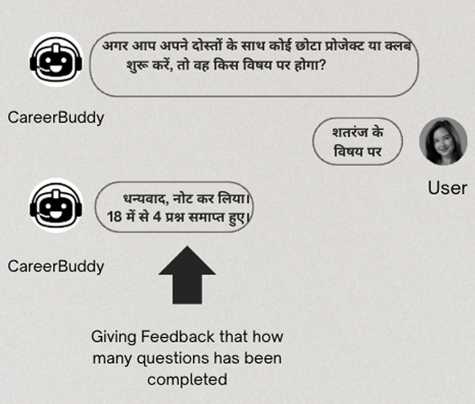
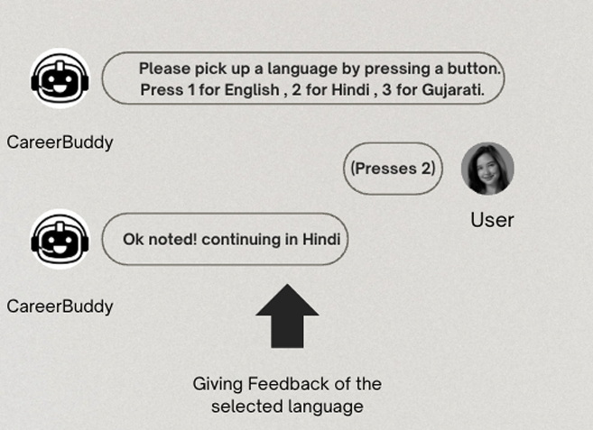
SYSTEM FEEDBACK

Slide 40
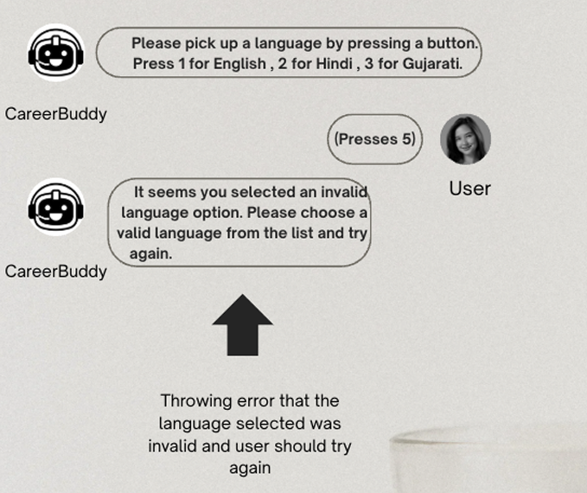
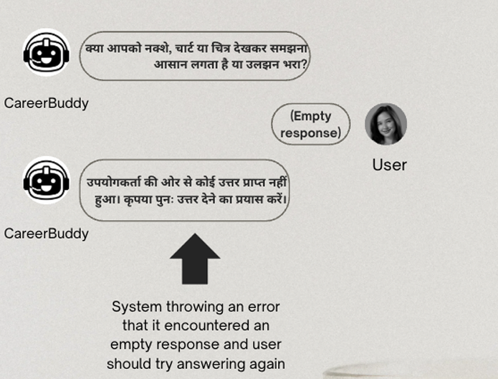
ERROR MESSAGES

Slide 41
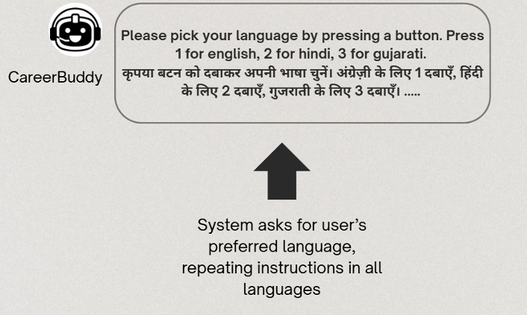
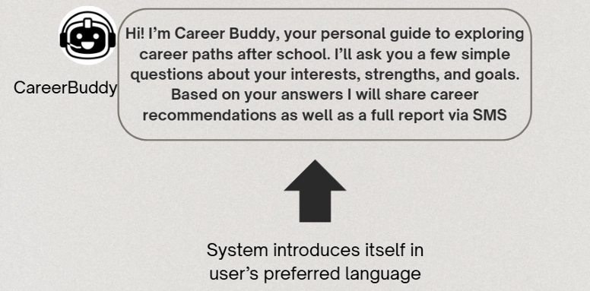
TASK INSTRUCTIONS FOR USABILITY TESTING

Slide 42
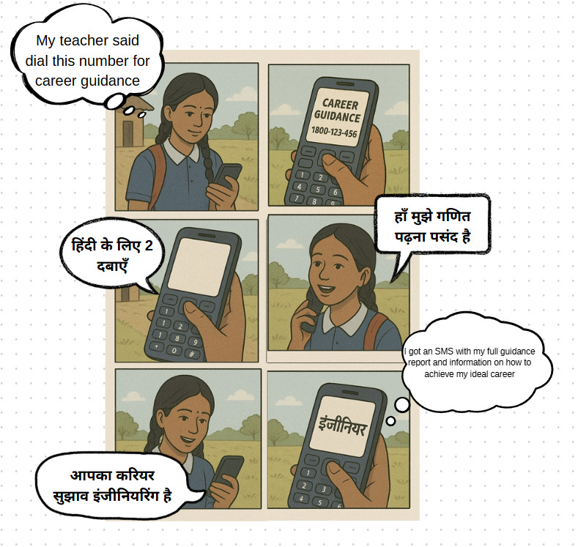
Storyboard - Prototype 2 ( Persona - Kaya )

Slide 43
THANK YOU!
Any questions? Suggestions?

